Slide 1
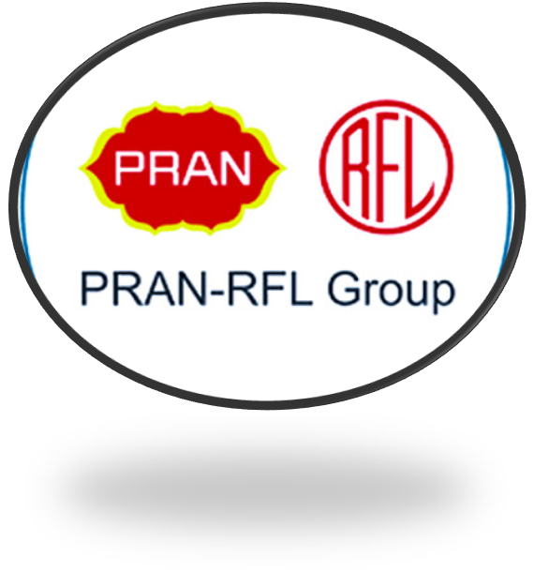
PRAN-RFL Group A RISING MARKET GIANT of BANGLADESH
Md Ashikur Rahman
3rd batch
Management Studies
01/06/2024

Slide 2
Introduction
PRAN-RFL Group is a leading food, beverage &amp; plastic industrial conglomerate &amp; market leader in Bangladesh. It is one of the most profitable companies of Bangladesh. Their mission and vision is to eliminate poverty and develop the agricultural sector of Bangladesh. Their motto is to generate employment and earn dignity and self-respect for our competitors. Since 1981 they are trying to develop our countries agricultural and rural area. Besides this they are the largest agro-processing company in Bangladesh. In this Term paper, we worked on the various factors on PRAN-RFL Group.

Slide 3
Key products and Services
Juices
Juice in Aseptic Pack
Juice in hot filled PET bottle
Juice in tin can
Juice in glass bottle

Slide 4

Drinks
In HDPE Shape Pak
Instant Powder drink
In HDPE Bottle -In PET bottle

Slide 5
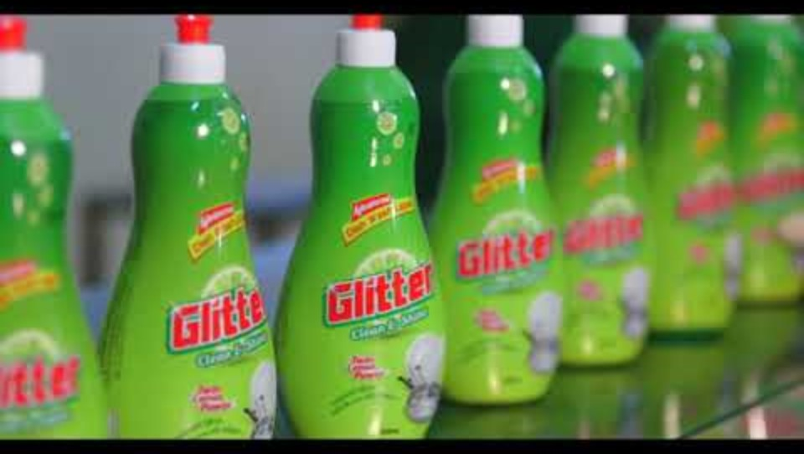
Video presentation of products Pran &RFL

Slide 6
Sales and Cost Statistics
Particulars | 2018 | 2019 | 2020 | 2021
Cost of Goods sold | 9,502,875,643 | 7,845,674,020 | 10,689,087,341 | 11,155,820,768
 | 2,786,767,051 | 2,399,288,691 | 3,415,043,879 | 3,900,636,632
Average Inventories
Inventory Turnover Ratio | 3.41 | 3.27 | 3.13 | 2.86

Slide 7
Conclusion
PRAN is one of the rising market giant of Bangladesh. After founding in 1981, PRAN- RFL Group is increasing their business rapidly. Now they are one of the largest conglomerate merger companies. PRAN-RFL Group has a total number of 37 concerns.

